Slide 1
Comprehensive Problem
Approach Definition
Notes:
1

Slide 2
Table of Contents
Problem Definition
Key Design Considerations
Solution Approach
Splitting Problem into smaller questions
UI / Workflow Definition
Question Navigation Approach
Status / Next Steps
Target
V2.0 Scope (Sept’19)
V3.0 Scope (Dec’19)

Slide 3
Problem Definition

Slide 4
Problem Definition
Requirement is to implement a Comprehensive Problem in the Accounting Courseware which is based on the skill set learnt in Chapter 1 to 3
The Problem involves an end to end evaluation of the transactions involved in the Accounting cycle
Create journals
Post journal entries to ledgers
Prepare a trial balance
Prepare financial statements
Journalize and post adjusting entries.

Slide 5
Key Challenges / Considerations

Slide 6
Key Considerations
Adding Comprehensive Assessment in the TOC
Ideally, this is not a Chapter and should not be numbered as a Chapter
Based on current support in the Application, we will add this as the Fourth Chapter in the Course. However this has been added to the Application backlog to address in the near future.
Splitting the problem into smaller questions
Facilitate Step by Step Assessment
Allow Splitting of data entries to reduce complexity and volume of data to be entered
Defining instructions, inputs and outputs for each of the Questions
Easy to use UI / Workflow
Address the challenge of displaying large data sets
Avoid too much scrolling or multiple scrollbars for a seamless user experience
Keeping the Instructions and the Grid visible in the Work Area
Navigation Approach from one Assessment to the other
Option 1: Carry Forward Student Values from 1 Assessment to the other Assessment
Penalizing the user only for the mistakes in the current question is Not Supported as of now
Option 2: Start each question with the Correct Answers.
Challenge – Restrict User from navigating to the next Question without Submitting

Slide 7
Splitting the problem into smaller chunks
Added an Introduction Section
Instructions for June - 4.2 to 4.7
Instructions for July - 4.8 to 4.13
Section# | Section Title
4.1 | Introduction
4.2 | Journalize the transactions for June
4.3 | Post the June journal entries to the ledgers
4.4 | Prepare the June trial balance
4.5 | Prepare the June income statement, retained earnings statement, and balance sheet
4.6 | Journalize and post the closing entries for June
4.7 | Prepare the June post-closing trial balance
4.8 | Journalize the transactions for July in the journal.
4.9 | Post the July journal entries to the ledgers.
4.10 | Prepare the July trial balance.
4.11 | Prepare the July income statement, retained earnings statement, and balance sheet.
4.12 | Journalize and post the closing entries for July.
4.13 | Prepare the July post-closing trial balance.

Slide 8
Proposed UI / Workflow

Slide 9
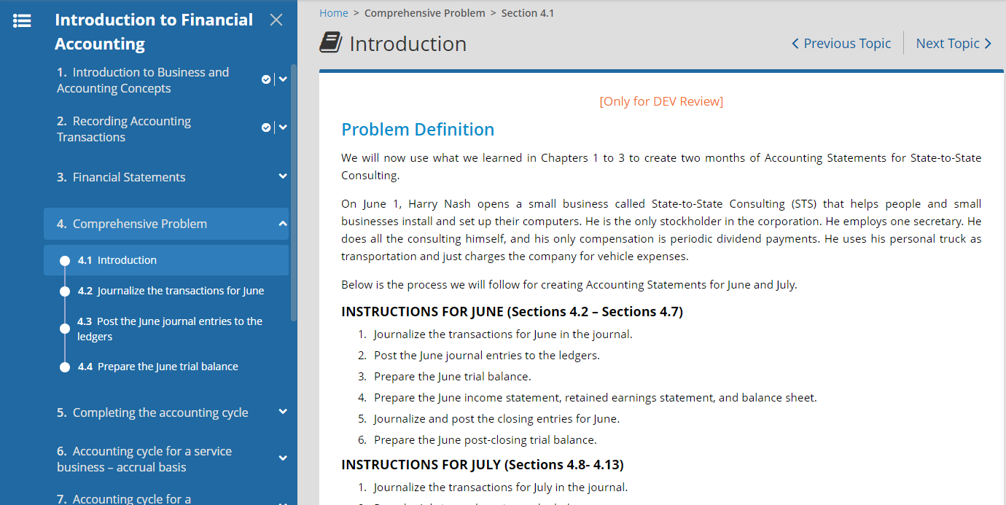
Proposed UI / Workflow
User Clicks 4.2

Slide 10
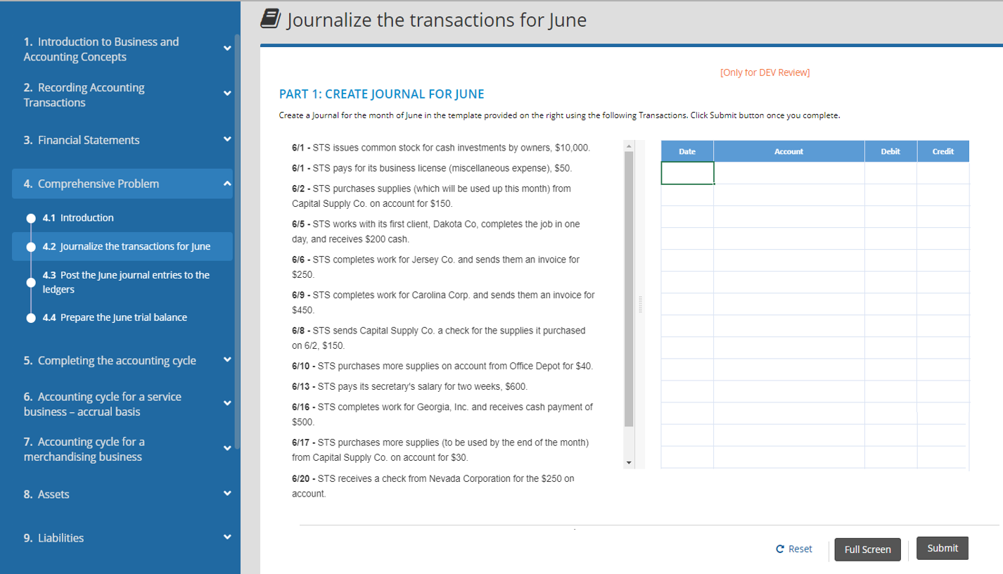
Proposed UI / Workflow
Side by Side Layout of the Question
Instructions on the Left
Question Grid on Right

Slide 11
Options to render Question Grids
Option 1: Full Screen / Pop up Mode
Option 2: Vertical Expansion

Slide 12
Option 1: Full Screen / Pop up Mode

Slide 13
Option 1: Full Screen / Pop up Mode
Support to Expand this area
User Clicks Full Screen

Slide 14
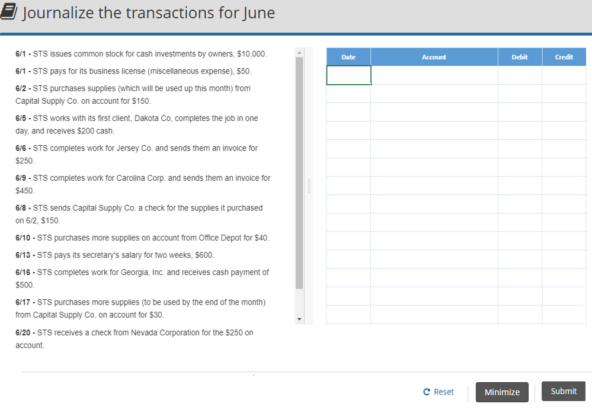
Option 1: Full Screen / Pop up Mode
Option to Submit in Full Screen Mode Also
Minimize and return to Main screen after completing the assignment

Slide 15
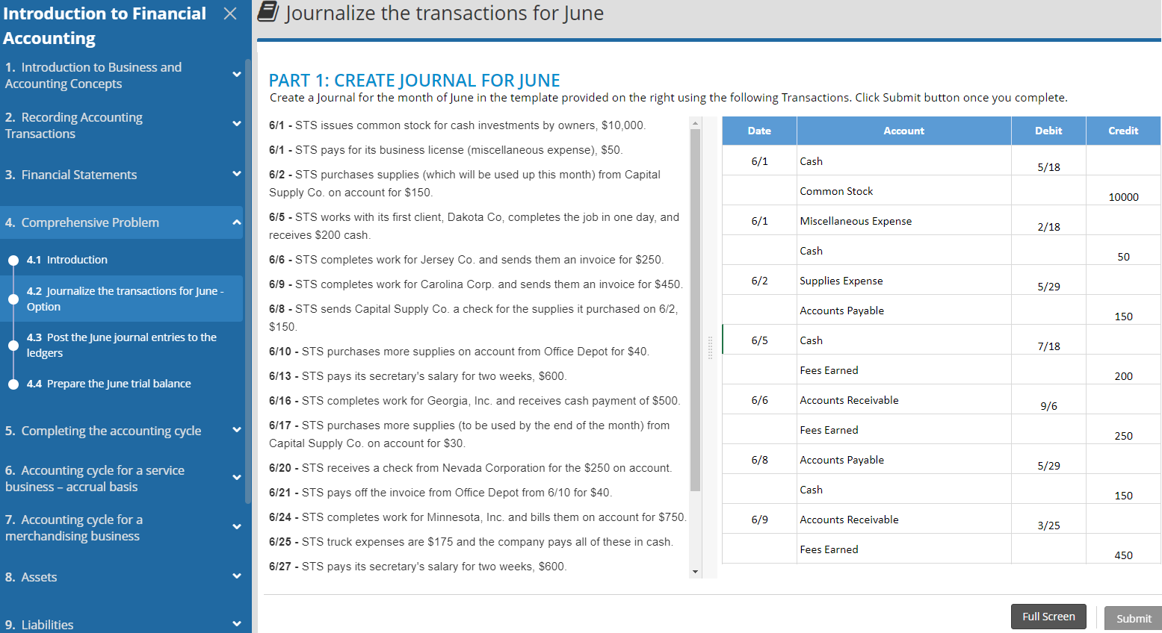
Option 1: Full Screen / Pop up Mode
Completed Assignment
Submit Disabled

Slide 16
Option 2: Vertical Expansion

Slide 17
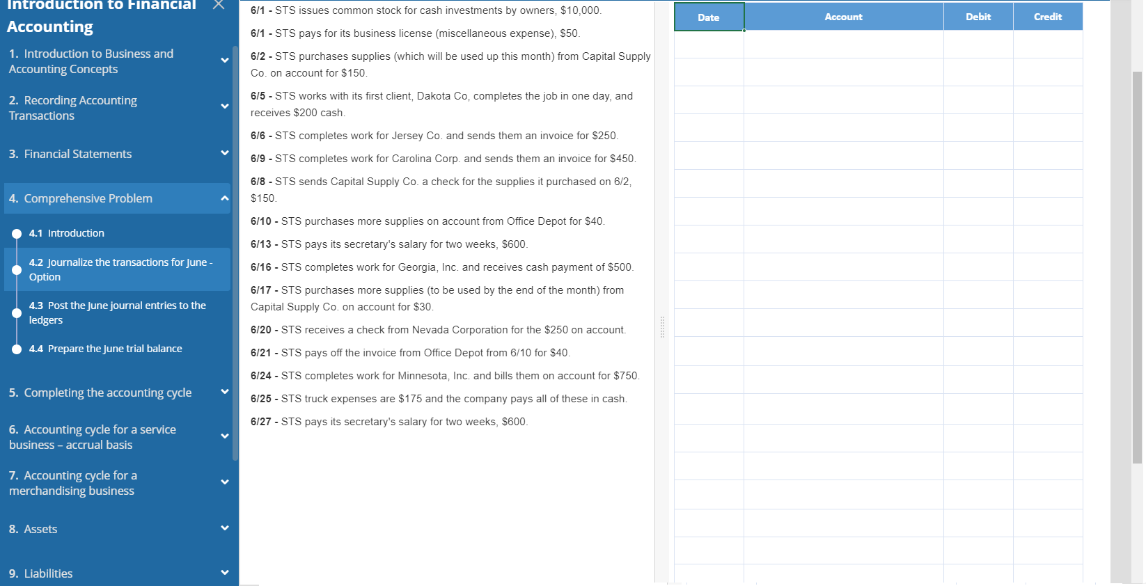
Option 2: Vertical Expansion
Scrolling controlled through Browser only

Slide 18
Navigation to other sections

Slide 19
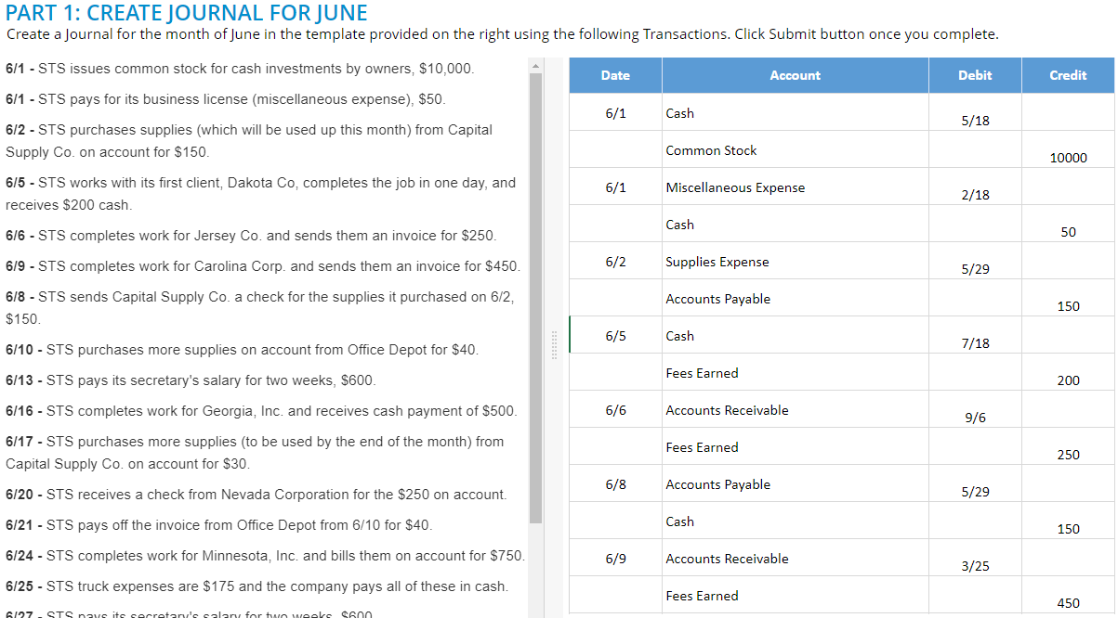
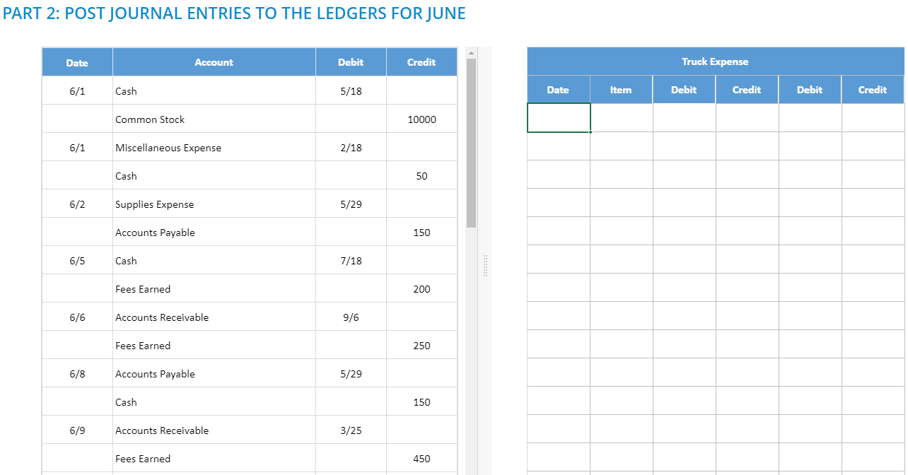
Navigation to next question - Issue
As each new Question is initiating with the default state (answer to the previous step), it is required to hide the next Step from the user until the previous step is submitted
In a case where user attempts to move to subsequent section without completing the previous section, the Question will remain locked for him
Appropriate message will be displayed to the user directing him to submit the previous question before moving on to the next question

Slide 20
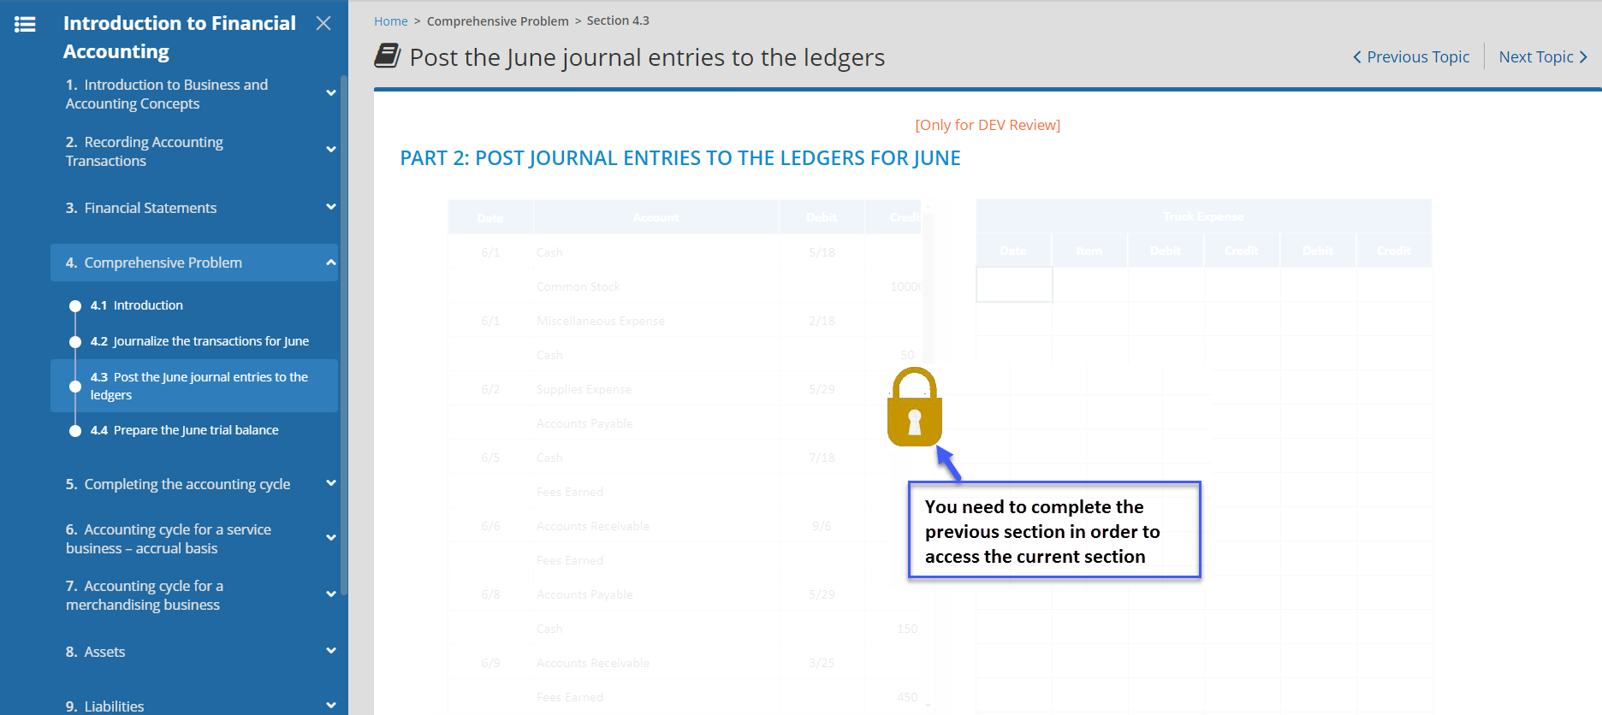
Navigation to other sections - Approach

Slide 21
Task List

Slide 22
High Level Task List
Content Authoring - Done
Understanding of the Problem – Done
Splitting Problem into smaller questions - Done
Approach Finalization – In Process
Implementation of Full Screen Mode / Expanded Mode – ?
Implementation of Restricting Navigation - ?
Finalization of UI – In Process
Content Ingestion – In Process
QA / Reviews – Not Started
? Anything else

Slide 23
Target

Slide 24
Target
V2.0 Scope (Sept’19) - Entries corresponding to June
Journalize the transactions for June in the journal.
Post the June journal entries to the ledgers.
Prepare the June trial balance.
Prepare the June income statement, retained earnings statement, and balance sheet.
Journalize and post the closing entries for June.
Prepare the June post-closing trial balance.
V3.0 Scope (Dec’19) – Entries corresponding to July
Journalize the transactions for July in the journal.
Post the July journal entries to the ledgers.
Prepare the July trial balance.
Prepare the July income statement, retained earnings statement, and balance sheet.
Journalize and post the closing entries for July.
Prepare the July post-closing trial balance.
INSTRUCTIONS FOR JUNE (Sections 4.2 – Sections 4.7)
Journalize the transactions for June in the journal.
Post the June journal entries to the ledgers.
Prepare the June trial balance.
Prepare the June income statement, retained earnings statement, and balance sheet.
Journalize and post the closing entries for June.
Prepare the June post-closing trial balance.
INSTRUCTIONS FOR JULY (Sections 4.8- 4.13)

Slide 25
Thank You!

Slide 26
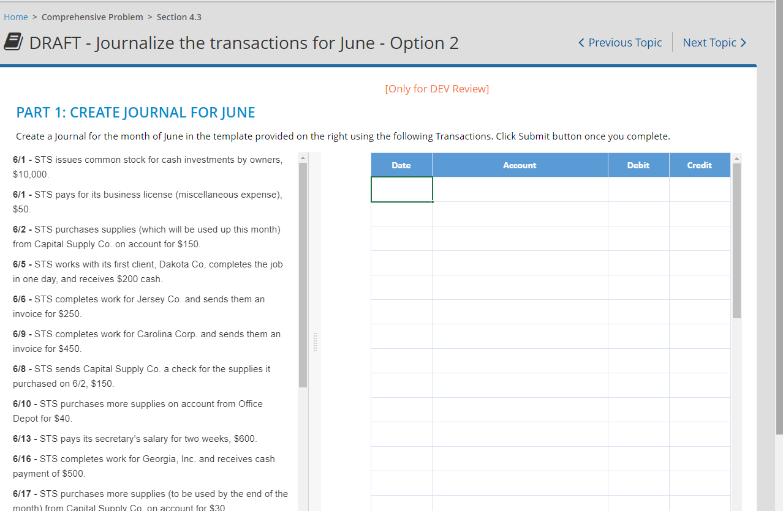
Proposed UI / Workflow - Issues
Current Scenario: Vertical Scrollbars due to existing limits
Scrolling at multiple levels required in order to complete the question which is not user friendly

Slide 27
Graphics

Slide 28
Requirements
A Widget with 2 panes
Panes Align left – Right (Side by Side) in default View
Can be Top / Bottom aligned also (Optional)
Expand / Collapse / Resize Options
Widget Contents in current scenario
Left Pane is expected as a instruction area
Tabular (Leonardo View)
Text Editor
Distinguishing between Question and Instruction Area
In case of Instructions in tabular format, there is a need to have a clear distinction between the instruction and question area by virtue of its appearance
Handling Multiple Tables in Question/ Instruction area
Excel tabs OR
Custom tabs OR
Vertical scrolling view

Slide 29
Requirements
Toolbar / Buttons
Can be a separate toolbar as a part of the player
Full Screen/ Minimize
Hint
Reset
Submit
Export/ Import (Optional)
Part of Experience APP
Zoomed View
UI to be decided
What contents will be displayed so as to have maximum work area?
Navigation Restrictions
Lock next section

